Slide 1
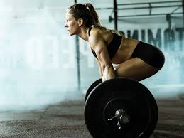
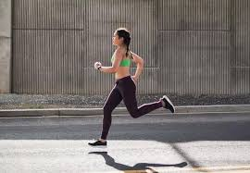
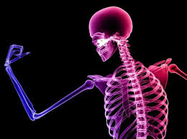

Nutrition and Exercise:
Thriving through Menopause
Deb Sloan, BSc, RD, CPT
Owner Debora Sloan Healthy Solutions
@dietitiandebs

Slide 2
Objectives
Physiology of Peri and Menopause
Benefits of exercise
Benefits of Strength training and cardio
Defining strength training
Body Re-comp myth/fact
Comparing strength modalities
Getting started
Maximizing workout efficiency
Programming ideas
Key nutrition considerations
Fuelling and Protein!

Slide 3
Peri and Menopause Physiology 101
Considerations for Nutrition and Exercise
Higher levels of inflammation (joint, soft tissue, gut, cvd, immune conditions)
Sleep disruption (vaso-motor or other)
Insulin resistance
Impact on gut and brain health, immune
Impact on mood and energy and cognitive function
Menstrual cycle - frequency, flow, deficiencies, cravings
Peri - Fluctuating levels of estrogen and progesterone
Testosterone may be impacted during this time
Menopause - lower levels to almost no active estrogen (estrodial/E2)
Estrogen receptors in multiple places
Estrogen plays a role in many systems Bone, BG, collagen, CVD, brain, other hormones, reproductive

Slide 4
Gender and Age Differences?
Linear loss of muscle mass, and vo2 max with age
Correlation exists between reduction of “power" in women of peri-menopausal years
Women have less baseline muscle mass and size (usually)
Lower baseline calorie budget
Women/Men similar relative capacity to build muscle and mitigate losses
Lower levels of active estrogen in women over 40 into menopause put them at higher risk of metabolic disorder, cardiovascular conditions, visceral fat, soft tissue injury and osteoporosis
Menopause itself does not necessarily impact muscle losses, ability to build or metabolism
Depending on SYMPTOMS training modality and recovery may look different
Customize and treat based on symptoms not gender/age

Slide 5
Pillars of Exercise
- All forms are necessary
- Not gender specific
- Different stimuli not necessarily interchangeable
- Maximize longevity and function
- Benefits beyond body composition
- Menopause makes it increasingly important
- When stimulus is present inevitability of decline is apparent
Strength
Cardiovascular /Aerobic
Daily movement
Mobility / Balance

Slide 6
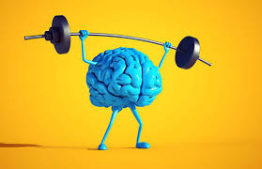
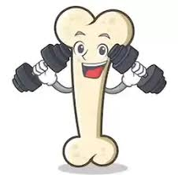
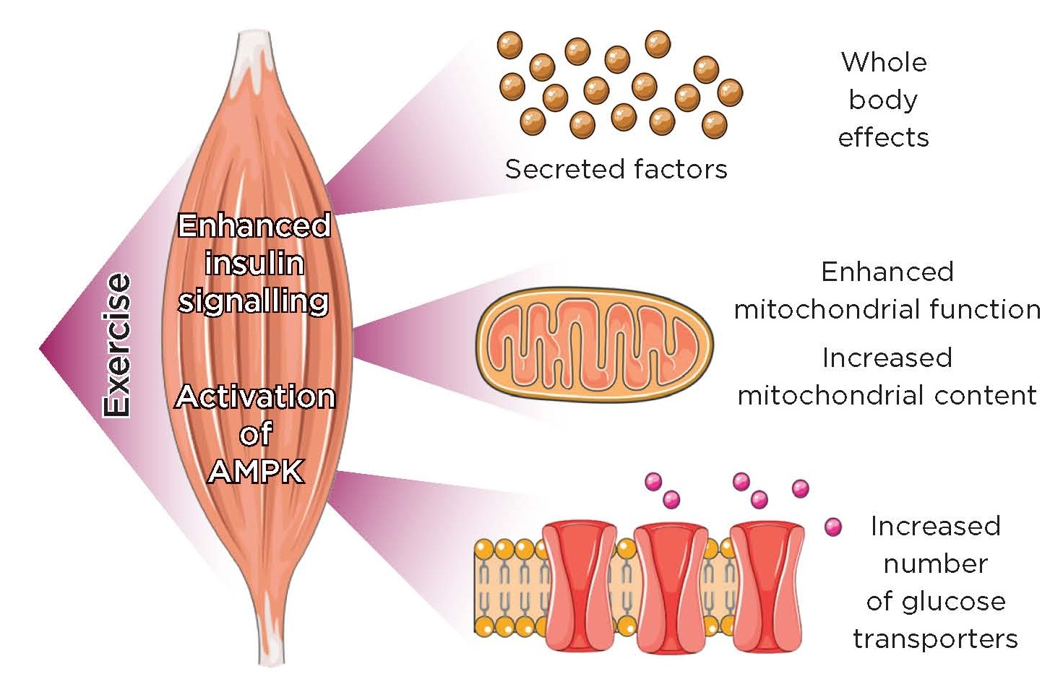
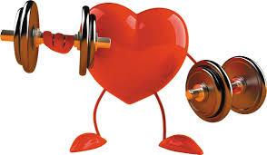
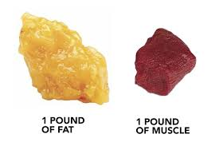
Benefits of Strength Training
Functional strength and mobility
Retains and BUILDS muscle mass and prevents muscle loss
Reduces inevitability of sarcopenia - 3-8% muscle loss per decade from age 30, women MAY suffer more)
Most important for BODY COMPOSITION change
Key component of metabolic health and metabolic flexibility (cholesterol, insulin resistance, visceral fat)
Prevents downward metabolic shifts during weight loss, aging, peri and menopause
Supports bones, reduces osteopenia risks
Supports joint health and reduces risk of injury AND falls
Regulates hunger hormones and positive impact on gut health (digestion and biome)
Improves sleep, energy, mental health - cognitive health, mood, reduces risk of dementia

Slide 7
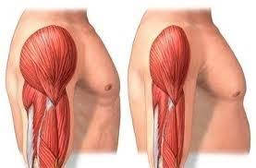
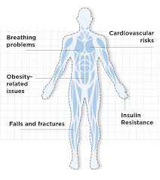
Strength training vs Other Exercise
“Cardio is a billable hours model
Strength Training is your investment in real estate”
- deb sloan
BMR calculation for women (metric)
BMR = 655.1 + ( 9.563 x weight in kg ) + ( 1.850 x height in cm ) - ( 4.676 x age in years )
Average 5’3 female at 150 lbs = 1200 kcal -1600 kcal (depending on muscle mass)
Wanna eat more? Change weight, Change output
Adding muscle mass/replacing fat with more muscle mass is the only real way to change your energy equation
All exercise is good
Both cardio and strength crucial to health
Only resistance training has an impact on Bone density and best correlated with falls prevention
Weight loss vs Body comp change
Highly metabolic (burns 3x as many kcal /lb as fat tissue —REE)
Containers for glucose storage AKA glycogen
Weight loss better maintained with strength training

Slide 8
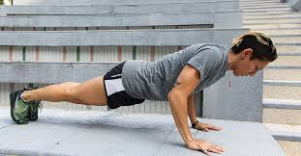
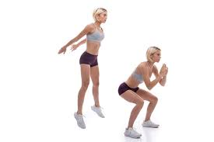
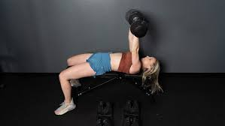
What actually is strength training?
Resistance/Load
Body weight exercises
impact exercises/Jump training
Can be achieved with higher loads OR more reps (safer for beginners)
Load, impact -> MUSCLE and BONE TISSUE
Progressive overload necessary for gains
Tissue damage -> Repair —> Growth
Volume and heavy loading are effective
Strength - more load less reps 3-8 rep range
Muscle mass (hypertrophy) - 5-30 rep range
Bigger muscles = more strength potential
Skill, technique, experience allow for more strength gains over time
Consistency is the most important
Key Messages:
1.Volume may be safer and more effective than load
2.Enough load and volume are necessary for gains
3. Must be hard enough and close to failure to get stronger and grow muscle
4.Progress with Frequency, Volume, Intensity

Slide 9
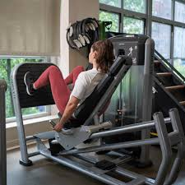
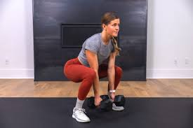
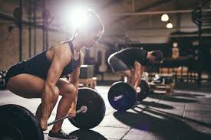
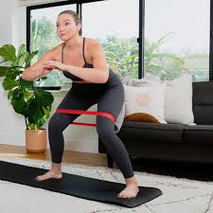
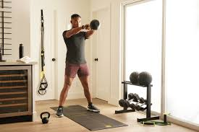
Comparing Modalities
Machines allow for stability, back support and safety to lift heavier
Free weights allow more flexibility with range of motion
Free weights challenge balance and stabilizer muscles and more core
Barbells allow for the heaviest lifting potential/weight distribution
Heavy barbell / dumbbell lifting requires more skill, balance, technique
Kettlebells are useful for full body explosive movements
Bands and body weight work well for foundations
Bands, Yoga and body weight NOT as beneficial for mass building or bone density
Which is best?
Doing a mix of machines, free weights,
body weight and barbell is great and can create the MOST varied and
well-versed program

Slide 10

Injury prevention
Assess sleep, recovery, nutrition
Start with light load and more volume
More warm up time and activation work
Joints and tendons of interest (toe, foot, elbow, wrist, achilles, gluteal, shoulder)
Very beginner or new modality add isometric work, tendon priming (calf raises, barefoot floor grips, rotator cuff, mini hops)
Use very basic foundational movements - bands, body weight, machines
Appropriate footwear or barefoot for lifting / body weight strength
Repeat workouts vs changing frequently
Progress with FREQUENCY —>VOLUME—>INTENSITY
1x 25 -repeat x 3d/wk
double leg calf raise
Side lying banded abductions (add hold)
Double or single leg bridges (add hold)
Prone Ws
Rotator cuff
seated dumbbell curls
banded straight arm pull downs
Cable triceps extension
Dumbbell wrist flexion extension
Reverse flys light weight or none
Dumbbell shoulder raises
Banded standing chest flys
Leg extensions (single leg) 12-15
Leg curls (single leg) 12-15
Plank hold

Slide 11
Tips for Maximizing Efficiency in Making Gains
3 x 10
Goblet Squat
Dumbbell Chest Press
Bent-over Row
3x10
Weighted Walking Lunge
Single Arm Press Kneeling
(Knee/wall) Pushups
3x 40 sec on 20 sec rest
Dumbbell Thruster
Russian KB Swing
Plank hold
3 x 10
Barbell Back Squat
Barbell Bench Press
Barbell Bent-over row
3x10
Front Rack Barbell Deficit Lunge
KB Turkish Get Up
Feet-elevated Pushups
3x 40 sec on 20 sec rest
Barbell Thruster
Full KB Swing (heavy)
Stability Ball Plank stir the pot
2 days/ week minimum 3 days is better
Full body over split body part
Compound movements (large muscle groups, multi joint)
Super-setting workouts
30 mins consistently 3x per week using the criteria above is effective
Lift with a RPE and RIR model to assess difficulty
Needs to be close to failure to adapt over time
Adding some HIIT or explosive jump work or full body acceleration movements as “Finishers” are awesome
Usually doing strength work at the beginning of sessions is best

Slide 12
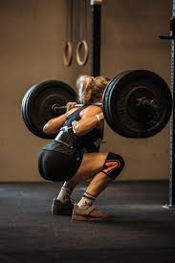
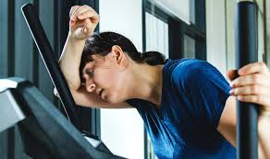
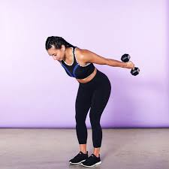
Not Seeing Results?
Common Mishaps and Solutions
Lift heavier - Progressive overload, RPE
Plug it in the schedule, work around injuries, do something over nothing, body weight when travelling
Get a coach to get started with proper movement
Find a program/gym/class/sport you enjoy
Follow a structured program for 6-12 weeks
Full body workouts WITH Compound lifts to hit more volume in the week
Consider a dietitian to help with calorie and macro targets, assess eating patterns, track food
Aim for 1 g protein/ lb IBW and some carbs around sessions
Get in some Cardio but prioritize strength
Superset circuits with less rest to save time
Increase steps
Consider polarizing your training - Strength Days, Rest days, Cardio days, HIIT
Take rest days and prioritize sleep and stress management
Not lifting heavy enough to adapt
Not being consistent
Not enough skill/coaching to progress well
Changing the program too often or never changing at all
Split body part workouts with too many isolated body parts/single joint
Not enough reps per muscle group (skipping legs)
Nutrition not considered (calorie balance, timing, fuelling, poor quality food)
Only doing cardio OR doing none
Short workouts and lots of sitting
Group classes that inhibit lifting heavier/change too often
Strength workouts that are TOO cardio focused
Not enough rest/poor sleep

Slide 13
Sample week
Heavy Day
3 x 5
Barbell squat
Barbell Bench
3 x 5
Bent-over Barbell Row
Barbell Deadlift
2 x 10
Landmine rotation
Side plank hip tap
500 m row
Train to fatigue Mix
3 x 10
Leg Press
Cable Lat Pull Down
Dumbbell Push Press
3x15
Loaded Hip Thrust
Reverse Fly
Single Leg RDL
2x10
Cable Paloff Press
Back Extensions
3x
15 Lateral Skater Lunges
250 m Sprint
Unilateral Volume
3 x 12
Front load slow goblet Squat
Alternating DB Chest Press
Pull up variation
3x12
Bulgarian Split Squat
Renegade Rows
Copenhagen Planks
3x12
Stability Ball Ham Curls
KB Clean and Jerk
Box Jump
Sled push interval
45 min Weighted Incline Walk
Plank routine
Mobility
30 min -60 min
zone 2 cardio of choice
REST

Slide 14
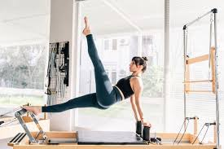
Pilates? Yoga? Bands?
All are good!
Improve some elements of strength, isometric, core, mobility, activation
Not calorie intensive
Not correlated with bone density
Unlikely to build a lot of muscle mass (size or strength)
Best accompanied by resistance training and cardio to mitigate sarcopenia and cardiovascular risk

Slide 15
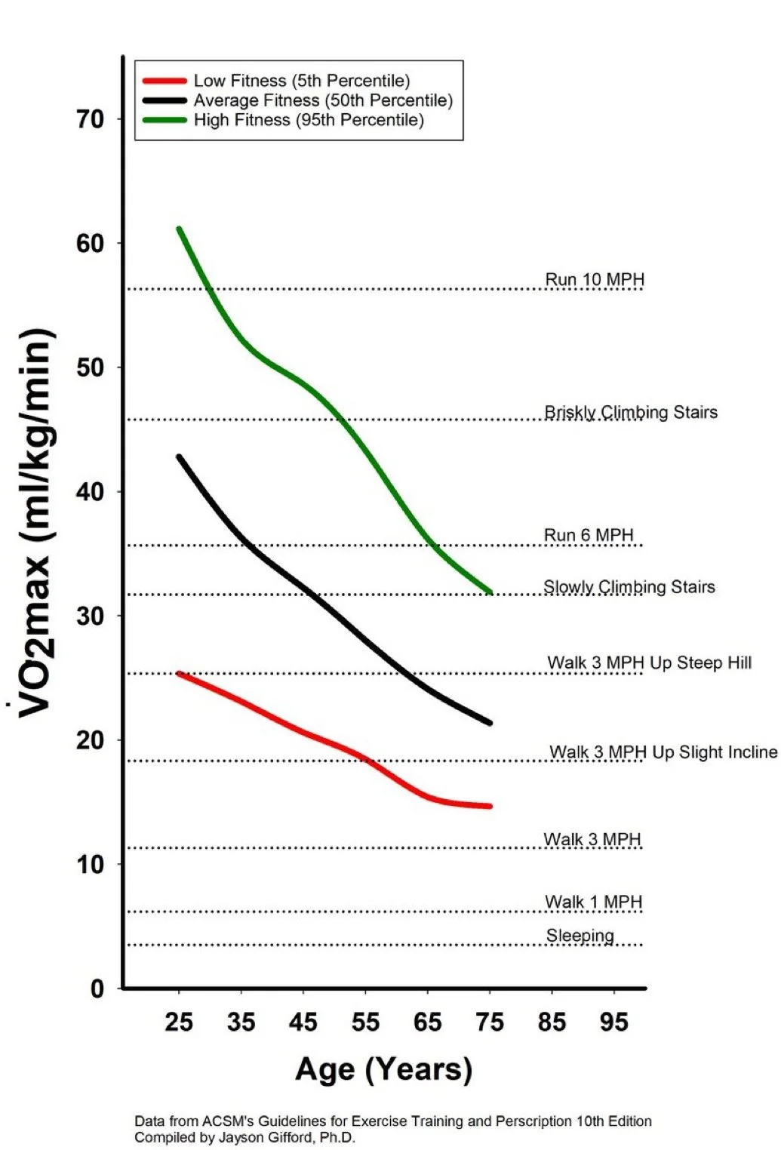
Cardio and Women 40+
What’s the evidence?
Don’t JUST do cardio (strength training is different)
Cardio is a key component of Maintaining V02
Age and reduction in V02 inevitable if not intervening
Vo2 (max rate of oxygen you can use) highly correlated with function and longevity
Effective for increasing expenditures (body comp)
Lower zone cardio effective for glucose and fat oxidation (cell adaptations)
Many metabolic and cardiovascular benefits (women >40 are at risk for these)
Multiple modalities for cardio that are safe AND easy to recover from (zone 2 bike)
Cardio NOT correlated with elevated cortisol
Chronic elevated cortisol is from ++ intense exercise + under fuelling + under sleeping

Slide 16
Fasted Training?
Pros and cons
Try both ways
How do you feel? Hunger management?
Type of exercise, intensity, duration, goals?
Low intensity fasted can increase mitochondria + adaptation + aerobic capacity!
High intensity, high volume , anabolic training may be better fed
No evidence based gender or menopause differences apparent

Slide 17
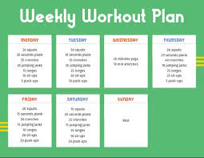
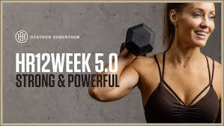
Set yourself up for Success!
Key Tips to Getting Started
Start small, keep it enjoyable
Set aside 20-30 min 3 x a week
Set your days and times to create consistent HABIT
Assess barriers/facilitators/what motivates you
Home gym set up for easy access?
Know your workout program in advance or follow a guided video
Build-up fitness on other days with cardio
Begin with body weight movements to prime your muscles
Progress to light loads and every couple weeks increase
Something is better than nothing
JUST GET STARTED: Build habit first then add, advance, perfect

Slide 18
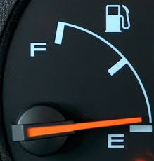

Fuelling Tips
Food is fuel for muscles and performance
For best results include protein and healthy carbohydrates around your harder workouts
Carbs are used best around exercise/active times
Meet daily protein needs 1g/lb IBW (100g/d)
Consume 30-40g protein within 1 hour after exercise (total daily protein is most important)
Hydrate well
Use electrolytes if out in the heat and sweating a lot >75 min
Reserve fasted workouts for low intensity sessions

Slide 19

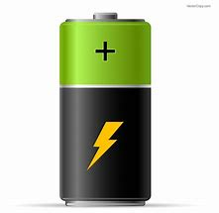

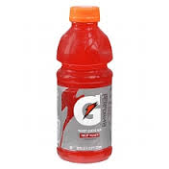

**Nuts/seeds and grains contain
protein but not significant amounts
Fuel and Recovery FORMULA for Snacking Success
PROTEIN FOODS
Meat, Poultry, Fish
Tofu, Tempeh
Dairy (cottage cheese, greek yogurt, milk/soy bev)
Eggs/Egg whites
Legumes/Edamame
Powders/Bars
CARBS FOODS
Fruits (dried/fresh/pureed)
Grains (cereals, rice, pasta, bread, oats)
Legumes (chickpeas, lentils, beans)
Starchy Veg (potato, corn, squash)
Juices, Sports Bev
Muffins, Pancakes,Bars

Slide 20

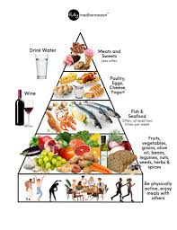
Best practice in Nutrition and Key Nutrients
Mediterranean diet
Fibre (25-35g/day)
Dietary Calcium ~1200mg/day
Whole foods mostly
Prioritize protein
Reduce carbs if less active / or if signs of high BG
Carbs from fruits and veg and whole grains and legumes
Eat more at meals less snacks
Reduce food near bedtime
Watch stimulants and alcohol
Magnesium, K2, Vit D, Omega 3,
Try Creatine 5g/d

Slide 21
PROTEIN
Tips:
Look for plain GREEK or SKYR
Add Low-fat Cottage cheese to a meal
Boost egg dishes and smoothies with Carton egg whites
Canned fish and beans are cheap and easy
Batch cook some staples for the week (tofu, chicken breasts)
Identify proteins: add to every meal and snack ~10-20g/snack 25-40g/meal
1/4-1/3 plate, palm size, 1g/lb IBW
Whole grains and beans over refined starches
Lean proteins heart health and calorie wise
Informed choice labelled protein powders and boost can work if needed
Building and Protects muscle and bone
Aging individuals >40 ++ muscle loss
Highest satiety of all macros
Higher thermic effect of food
Higher IRON and B12, Calcium
Regulates BG and hunger
Less likely to be stored as fat
Higher intake safe for most, linked to better body comp
Plant eaters, Aging, Women, Peri/menopausal need more
Correlated with less snacking, better energy and mood
Diets higher in LEAN proteins work well for sustainable weight loss
Meet daily protein needs 1g/lb IBW (100g/d) More may be beneficial if trying to lose weight or have a larger appetite

Slide 22
Sample Day
20-30g protein per meal
5-15 g protein/snack or healthy fats
Fibre / whole food choices
Colour on the plate
Veggies or Fruits included
Pre workout Fuel (protein/carbs
Easy, grab-able, minimal prep
To increase/decrease calories:
How much Fats? (nuts, dips)
What are you drinking?
Snacking?
Check in on portions
Nutrient vs Calorie dense

Slide 23
Evidence-Based Folks and Influencers TO Follow!
Exercise-Science, Nutrition, Women’s Health and Menopause-related stuff
Alan Aragon (@thealanaragon)
Bret Contreras (@bretcontreras1)
Layne Norton (@biolayne)
Alyssa Olenick (@doclyssfitness)
Tony Boutagy and ALL the people on featured on his podcast (@tonyboutagy)
Stuart Phillips (@mackinprof)
Lauren Colenso-Semple (@drlaurencs1)
Dr. Spencer Nadolsky (@drnadolsky)
Emma Storey Gordon (@esgfitness)
Menopause Dietitians: Elizabeth Ward, Hilary Wright (@menopausedietplan)
Dr. Jenn Huber (@menopause.nutritionist)
Coven Women’s Health (@covenhealth)

